Slide 1
FAIRification process activity tracker dataset
FAIR Data Engineering – Group 10
Victor Alecu & Vlad Gosa

Slide 2
Fitness tracker dataset
Description
FAIR Issues
.csv formatted synthetic fitness data.
Sourced from Kaggle (CC0 license)
12 columns (ints, doubles, strings, dates)
1 million rows (reduced to 10k)
Metadata on column descriptions, provenance, license, use cases
F1: Non-persistent identifier
F2: No rich metadata
F3: No data identifier in metadata
A2: Metadata doesn’t have longer persistency than data
I2: Metadata represented in a semi-structured way
I2: (Meta)data does not use vocabularies following the FAIR principles
I3: (Meta)data does not include qualified references to other (meta)data. Only Kaggle recommendations
Reuse stakeholders
Researchers
Companies (marketing departments)
Students
Semantic Web users

Slide 3
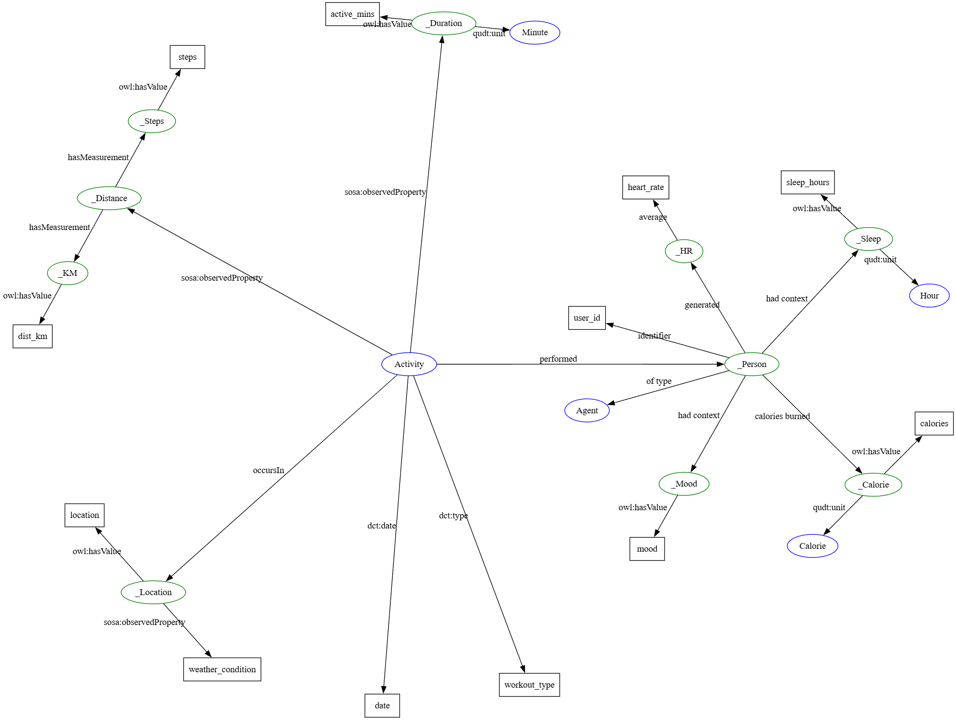
Semantic Data model

Slide 4
Metadata properties beyond fdp schema
Title
Description
Plaintext – enhances human readability
Source (dct:source)
Location from which the original dataset was obtained (in our case Kaggle)

Slide 5
Improvement in Fairness
F1: Globally unique and persistent identifier through w3id.org/permaId
F2: Rich metadata
F3: Data identifier with clear predicate in metadata
F4: Can now also be accessed through w3id.org/ permaId GitHub repo (not only Google)
I1: (Meta)data is now triplified, has public schema, and uses text/turtle IANA media type
I2: (Meta)data is linked to resources which follow the FAIR principles
I3: (Meta)data points to qualified references of resources which follow the FAIR principles

Slide 6
Thank you for your attention!

